Slide 1

LaserGAN: Generating Laser Profiles with Deep Learning
Project Team - Josh Wang, Nikhil Goduguluri, Aradhya Mathur, Richa Yadav
Project Advisor - Professor Ajay Anand
UR-LLE SPOC - Mark Guardalben
Page 01
Notes:
RICHA

Slide 2
Contents
Introduction
Project Objectives and Mission
Project Milestones
EDA
Modelling and Results
Conclusion
Page 02

Slide 3
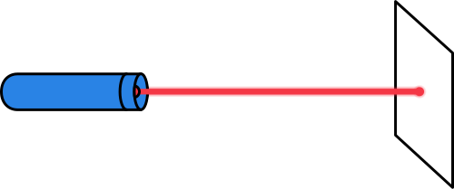



What does UR-LLE do?
LASER-DRIVEN FUSION
Lasers irradiate a pellet of inert gas
ENERGY RELEASE
Nuclear fusion produces a significant energy output
ELECTRICITY GENERATION
Captured fusion energy can be used to generate electricity
Page 03

Slide 4
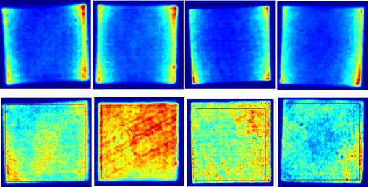

Project Objectives
Create a tailored generative model for UV laser output prediction.
Reduce prediction time for output profiles significantly.
Maintain high accuracy and reliability in predictions.
Ensure the model’s adaptability and scalability.
Laser Input Beams
Beamline 1
Beamline 2
Beamline 3
Beamline 4
Generative Model
Laser Output Beams
Page 04

Slide 5





Our Project Mission
Accuracy
Robustness
Is the proposed model capable of making energy prediction with low MSE?
Can the proposed model perform as expected (high accuracy) on unseen data?
Speed
Scalability
Can the proposed model train and make predictions relatively faster than the physics based model?
Is the proposed model platform-independent and can scale upto to large datasets?
Page 05

Slide 6
Project Milestones
Sr No. | Milestones | Projected Date | Completion Date
Milestone 1 | Project charter completed | 10/03/23 | 10/03/23
Milestone 2 | cGAN test run completed on the initial dataset | 10/10/23 | 10/10/23
Milestone 3 | cGAN tested on more data | 10/24/23 | 10/24/23
Milestone 4 | UNet model developed | 10/31/23 | 10/31/23
Milestone 5 | UNet model completed and discussed first draft of CLEO | 11/07/23 | 11/07/23
Milestone 6 | cGAN and UNet deep learning models compared. Scaled models on Bluehive (A100) | 11/17/23 | 11/17/23
Milestone 7 | Finalized the CLEO paper draft. | 11/27/23 | 11/27/23
Milestone 8 | Completed Final Presentation and Report. | 12/6/23 | 12/6/23
Page 06
Notes:
RICHA

Slide 7
Exploratory Data Analysis
Page 07
Notes:
NIKHIL

Slide 8
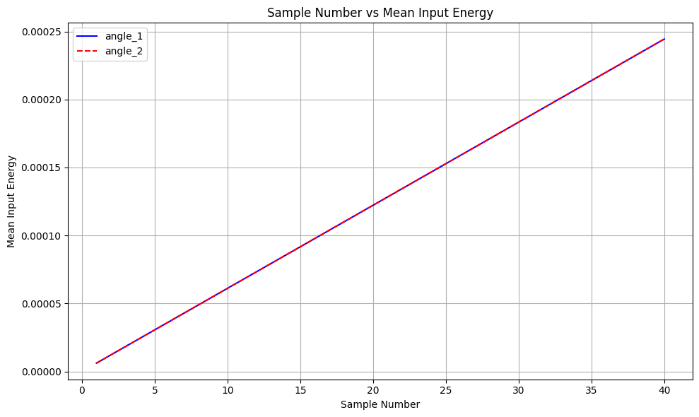
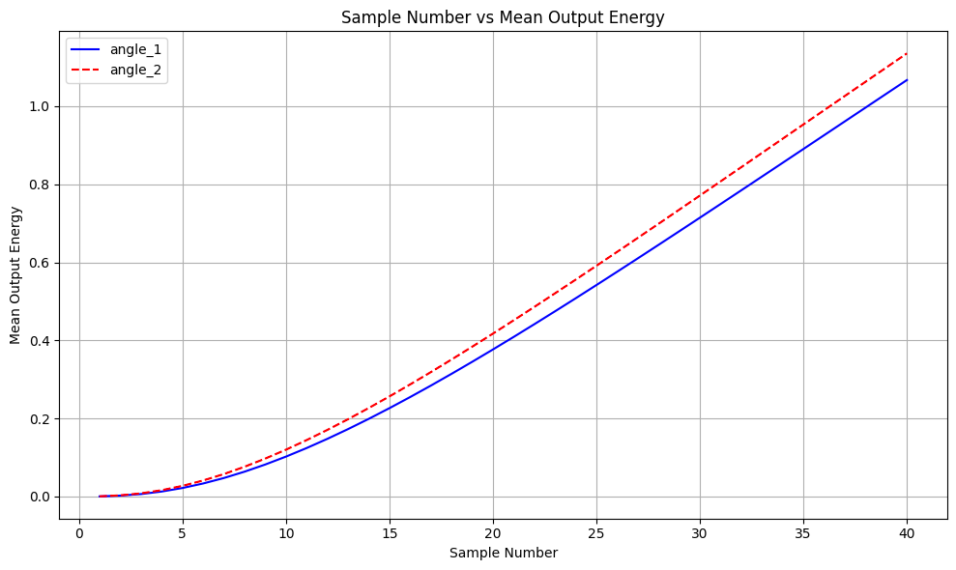
EDA- Mean Value Comparison
Different energy profiles result in different amplification!
Page 08

Slide 9
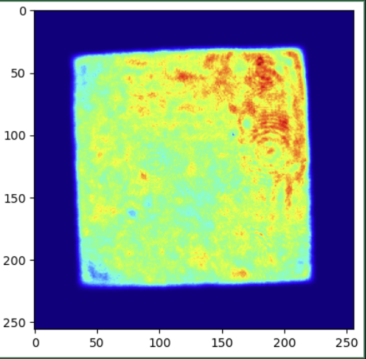
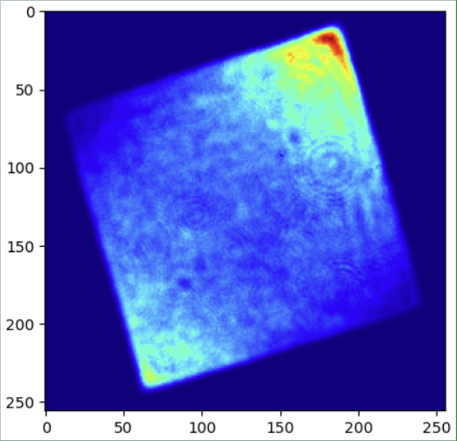
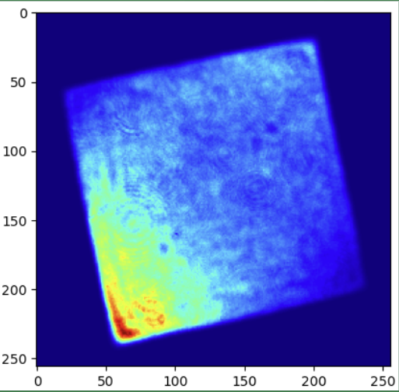
EDA- Spatial Dependence of the Nonlinear Transfer function
For 3 different angles, we took 20th image (same mean input energy) for each of the angle to see the difference in energy profile of outputs
Angle 1
Angle 2
Angle 3
Although the mean of input for these 3 are same, outputs are very different because of Nonlinear Transfer function!
Page 09

Slide 10
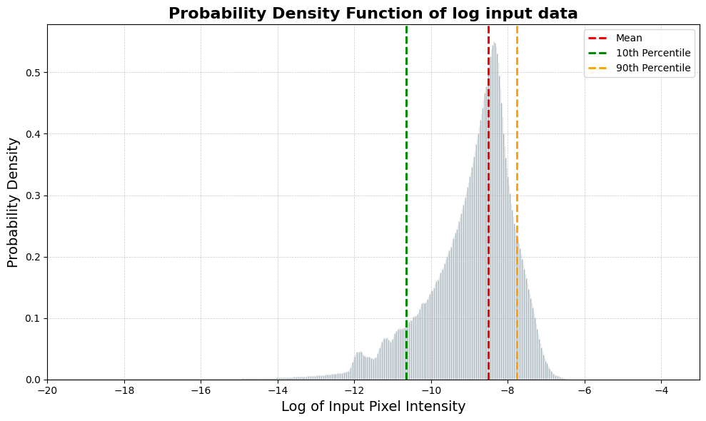
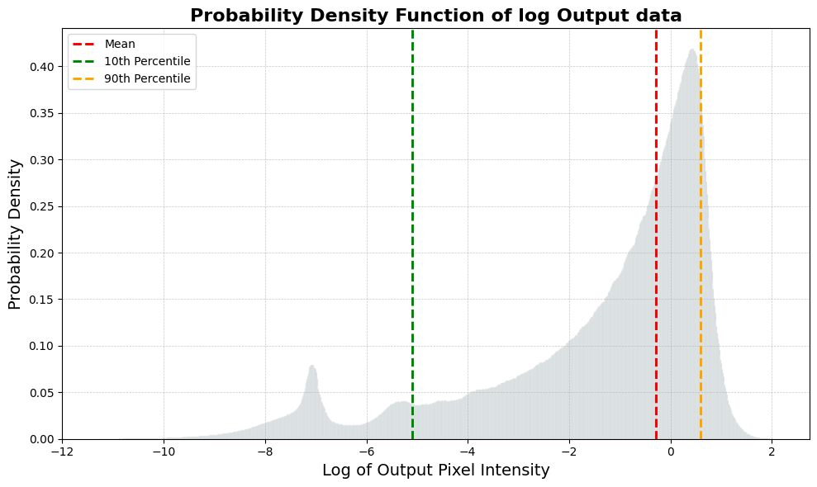
PDF of input and Output data
Both input and target images have wide range of values
input images
10 th percentile : 2.36e-5
mean: 0.0002
90 th percentile: 0.0004
output images
10 th percentile : 0.006
mean: 0.751
90 th percentile: 1.798
Page 10

Slide 11
Preprocessing
No preprocessing!!
Traditional image preprocessing like rotation, scaling, noise injection, resizing etc. helps the model to perform better on unseen data.
In our scenario, this doesn’t apply because
These are not Images but Energy maps.
There won’t be any surprises!!
Page 11

Slide 12
Modeling Methods and Results
Page 12

Slide 13




UNet Model
(Only Generator)
PYTORCH IMPLEMENTATION
U-Net is a popular CNN architecture used in semantic image processing.
Consists encoder - decoder architecture, and skip connections
Skip connections help to mitigate the problem of information loss during downsampling process in the encoder.
Page 13

Slide 14
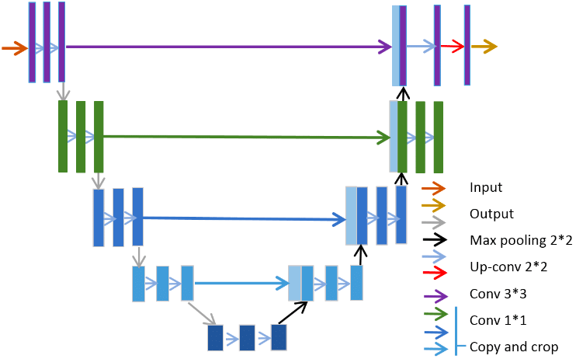
U-Net Architecture
Page 14

Slide 15
U-Net training
U-Net Model
Input
Output
Training objective: minimize (MSE( Target, Output ))
Page 15
Notes:
NIKHIL

Slide 16








Pix2Pix
(Generator and Discriminator)
PYTORCH IMPLEMENTATION
Feedback for Generator
Generator
Discrimator
UNet generator
Real or Fake?
Uses PatchGAN
Generator in action
Predicted image
Input
Predicted image
Actual
Image
Built on Conditional Generative Adversarial Networks, with an image as a condition rather than random noise.
PatchGAN discriminator analyzes patches of images rather than the entire image, optimizing for local image structure.
Page 16
Notes:
JOSH

Slide 17
Pix2Pix training
Generator training objective
minimize (MSE(target,output) + Lambda*BCEL(fake_disc_output, np.ones(30,30)))
Input
Generator
output
Input
Discriminator
fake_disc_output
Discriminator training objective
minimize (BCEL(true_disc_output, np.ones(30,30))+
BCEL(fake_disc_output, np.zeros(30,30)))
output
Input
Discriminator
real_disc_output
target
Page 17

Slide 18
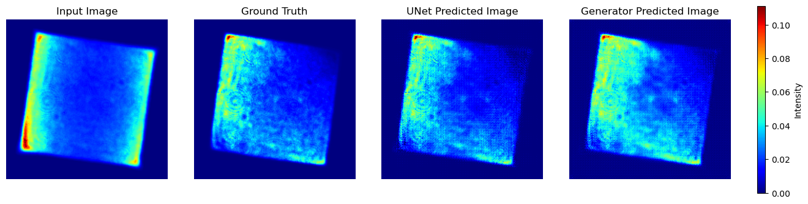
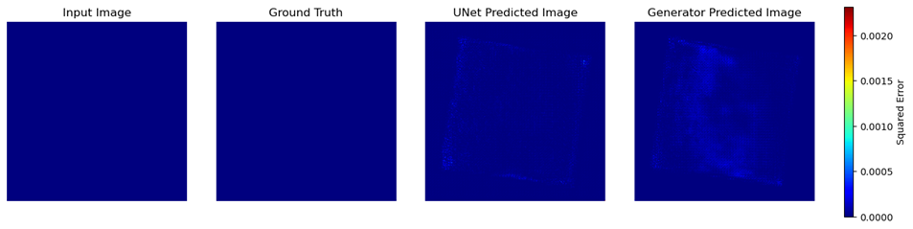
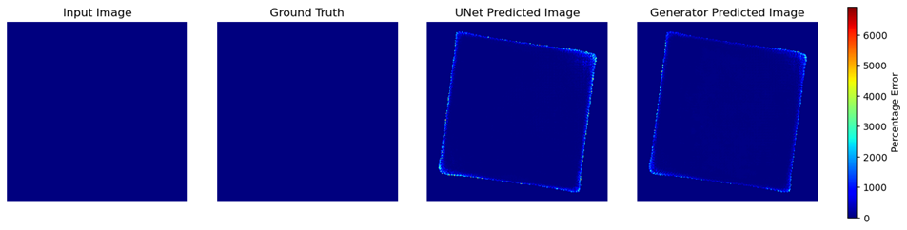
MSE is a more meaningful evaluation metric than MAPE
RESULT: SPATIAL DISTRIBUTION OF ERRORS
Mean Squared Error (MSE)
Mean Absolute Percent Error (MAPE)
Page 18

Slide 19
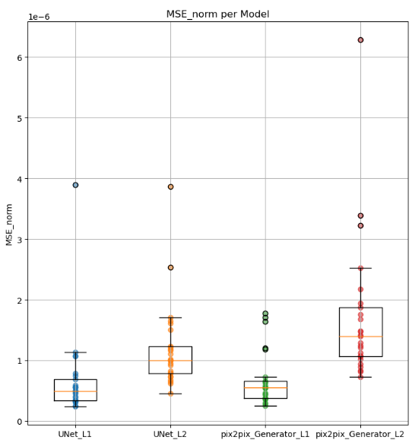
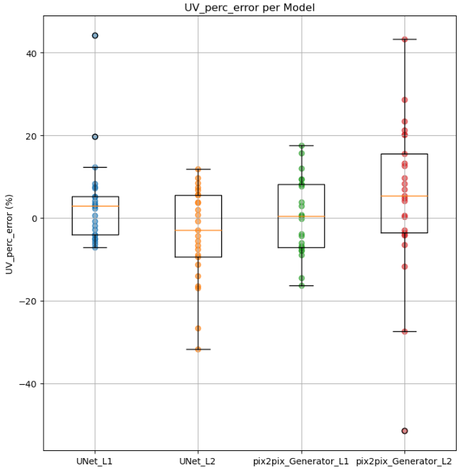




L1 models outperform L2 models
Recursively trained each of the models 25 times. Each model iteration was tested on 20 bootstrapped test datasets.
UNet L1
UNet L2
Generator L1
Generator L2
MSE (normalized)
UV percent error
*unet - unet with L1 loss; unet_L2 - unet with L2 loss; generator - pix2pix with l1 loss; generator_L2 - pix2pix with L2 loss
Page 19

Slide 20
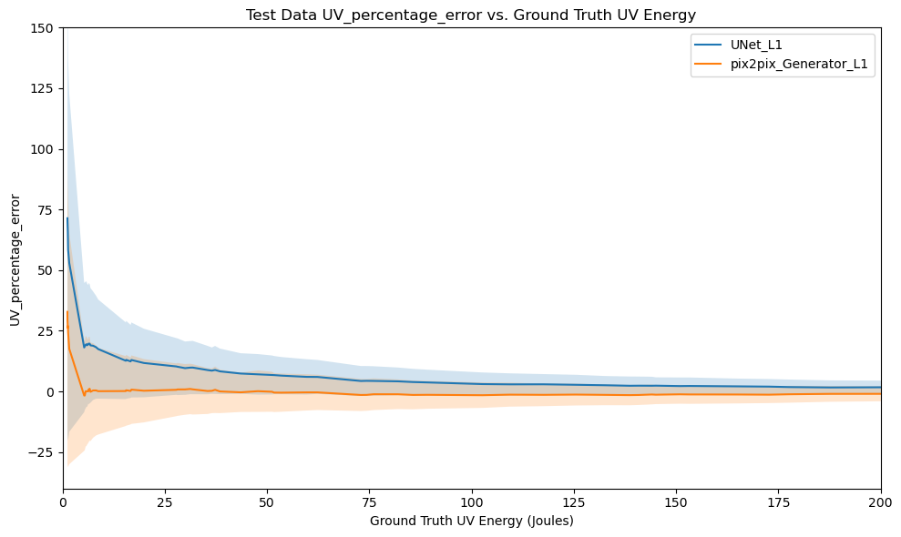
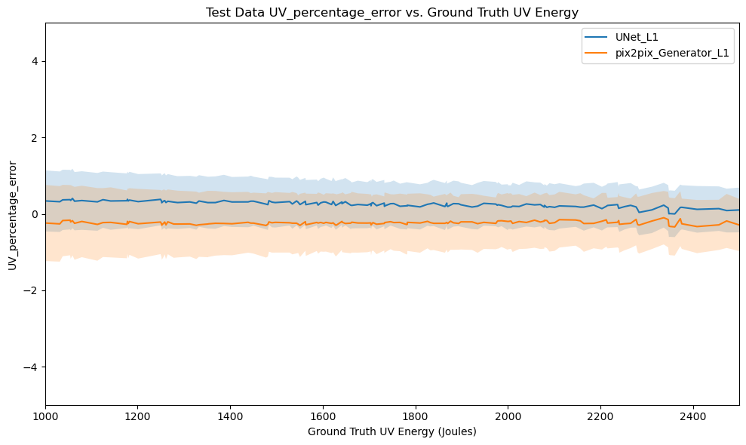

pix2pix Generator is better than UNet for low energy outputs
UNet L1
Generator L1
Page 20
Notes:
Josh

Slide 21

Accuracy looks promising but what about the model’s speed and scalability?
Page 21

Slide 22
Introducing model trials on
Nvidia Ampere A100 40GB GPU !
Huge thanks to Professor Brendon Mort and the compute resources
offered by BlueHive!
Page 22

Slide 23
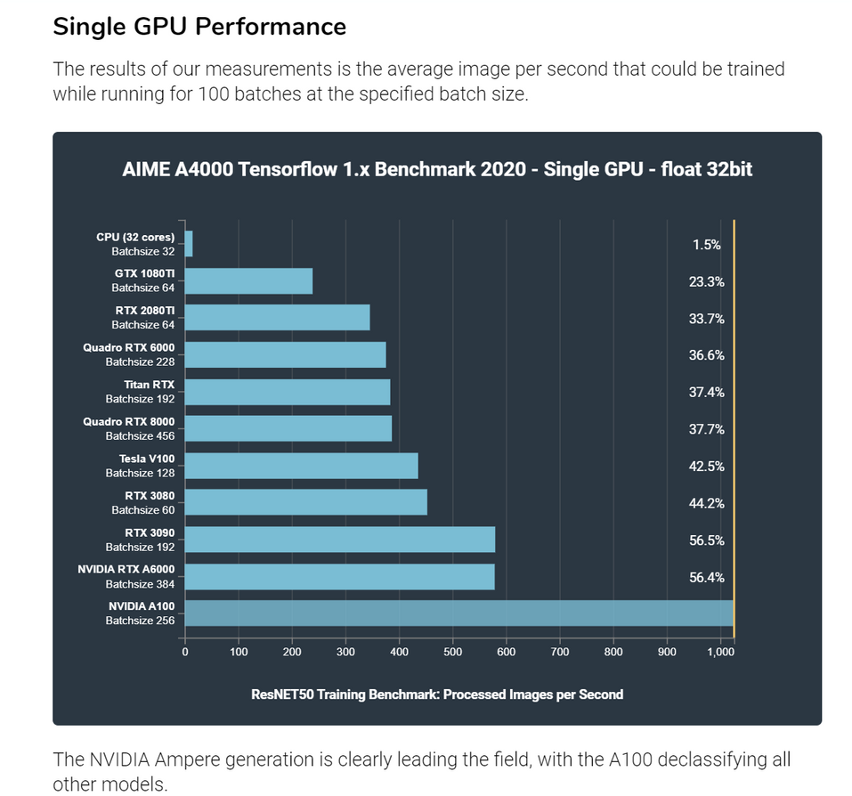
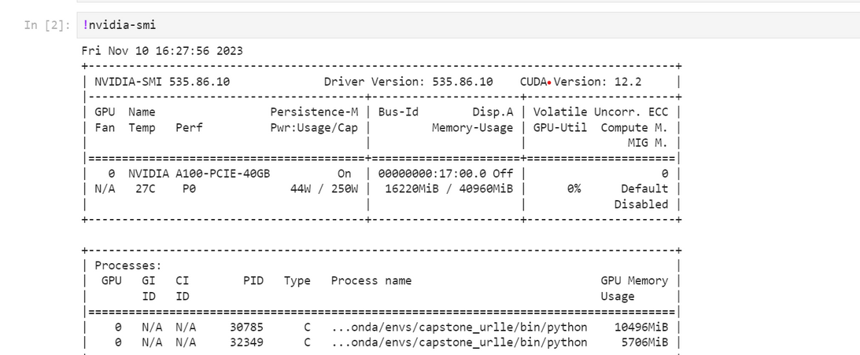
To put computing capacity of Nvidia A100 in perspective...
The NVIDIA A100 has 432 tensor cores and 40 GB of high-bandwidth memory in comparison to RTX 3090 which has 328 tensor cores and 24 GB GDDR6X.
In layman terms, the A100 can be up to 20 times faster than the previous generations.
In order to test our model’s platform independence and scalability, we did model trials on the A100 GPU.
https://www.aime.info/blog/en/deep-learning-gpu-benchmarks-2020/
Page 23

Slide 24

How did A100 perform for our use-case?
Training time for 1088 image pairs for 300 epochs
Mean MSE for UNET : 0.0004
Mean MSE for Pix2Pix : 0.0004
As evident from the training time speedup in the chart beside, the UR-LLE team can utilize high-end GPUs to speed up the algorithm on large datasets without compromising accuracy.
minutes
Page 24

Slide 25
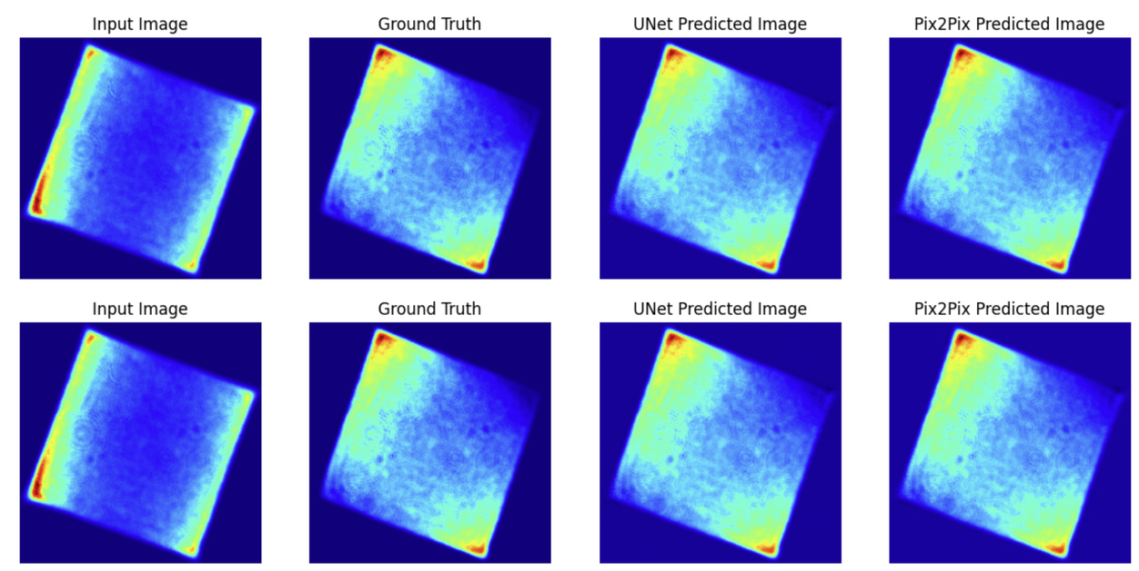
How does the model perform on unseen energy pairs?
Hold-out test set: Run number 53
Training dataset: Run numbers 20 - 52
Accuracy
Mean MSE for unet: 0.0004
Mean MSE for generator: 0.0008
Page 25

Slide 26

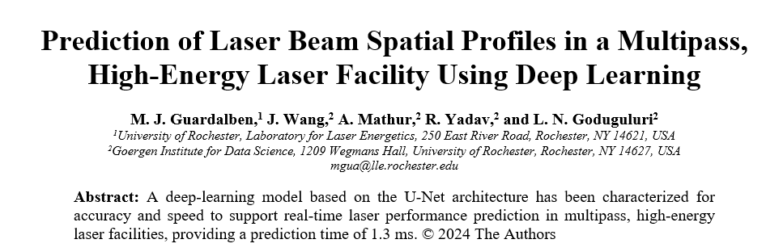
Paper Publication at the CLEO conference
We are happy to announce our authorship and participation in CLEO conference led by Mark.
Technical Conference: 05 – 10 May 2024
The CLEO Hub: 07 – 09 May 2024
Location: Charlotte Convention Center,
Charlotte,North Carolina, USA
Page 26

Slide 27





Our Conclusion
Our Progress
ACCURACY
SEP
‘23
OCT
‘23
NOV
‘23
DEC
‘23
Accuracy
Robustness
Can a deep learning system be build to predict laser output energies (faster than the physics model)?
Yes, we built two models that can predict output beams within 5% error threshold!
Tested the models compatibility with A100 GPU and laid the ground work for CLEO conference
Wrapping up!
Speed
Scalability
Page 27
Notes:
Mark presented us with an interesting challenge and the last 3 months have been invested for a fruitful conclusion.
We are offering 2 highly scalable deep learning models for the accurate prediction of output UV laser beams.

Slide 28
Acknowledgements
We greatly appreciate the support given to us by:
UR LLE
Professor Ajay Anand, Professor Cantay Caliskan from the GIDS dept
Professor Brendon Mort and BlueHive support team
Page 28

Slide 29
Next Steps
We completed solid groundwork for the CLEO paper publication for May 2024. This conference will be led by Mark and we hope to see positive responses for our work.
The UR-LLE team can decide on which model can be useful for their laser scientists and deploy the model for active use to make better strategies.
Page 29

Slide 30
Challenges
PyTorch vs TensorFlow : Converting the cGAN code to PyTorch for better comparison.
Page 30

Slide 31
Thank you!
Page 31

Slide 32
Questions?
Page 32

